Slide 1
HOTEL MANAGEMENT SYSTEM
Presented By:
Meher Jain
Radhika M. Paryekar
Subir Padhee

Slide 2
OVERVIEW
A Hotel Management System in the form of a stand-alone application.
It will allow customers, hotel administrative staff and other employees to access the hotel services, administrative activities and employee services respectively.

Slide 3
USE CASES IMPLEMENTED
The User can sign up in the system depending on his/her role.
The User can log in to the system
The Customer can check room availability and make a booking
The Customer can view the food menu and order food
The Customer can view and pay bill for room booking and food
The House Keeping staff can view and update the supply inventory
The Catering staff can view and update the food inventory

Slide 4
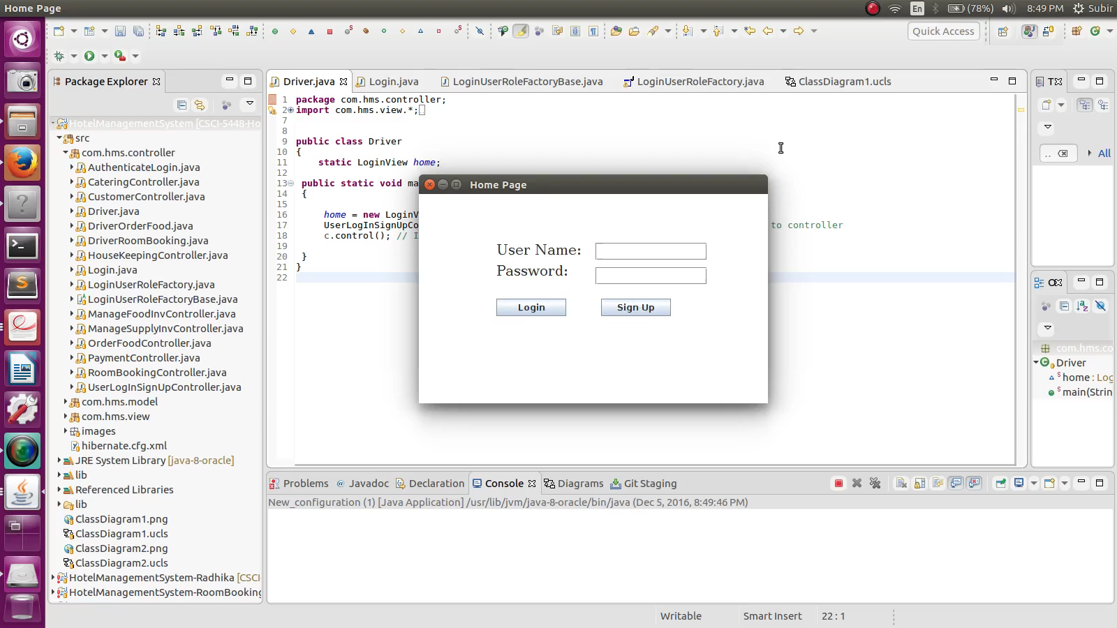
DEMO

Slide 5
DESIGN PATTERNS
Factory Method
Singleton
MVC (Architectural Pattern)

Slide 6
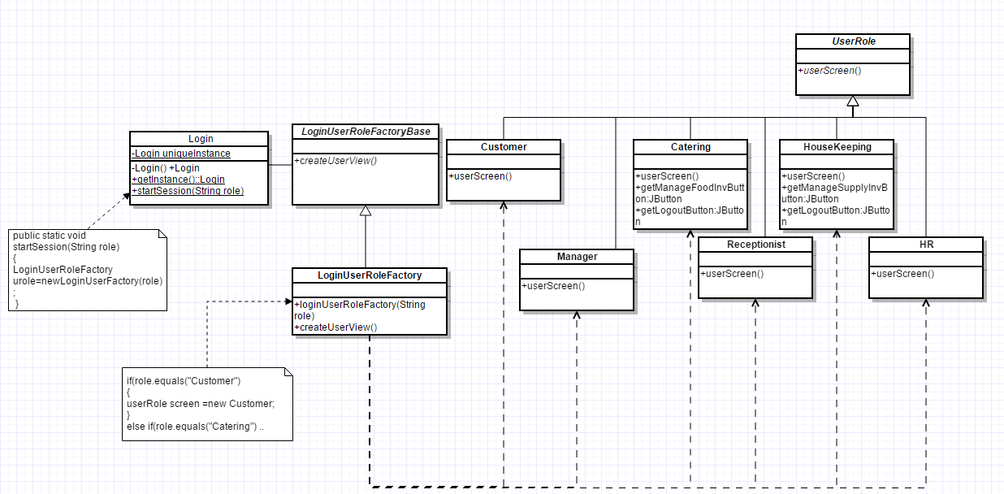
FACTORY METHOD

Slide 7
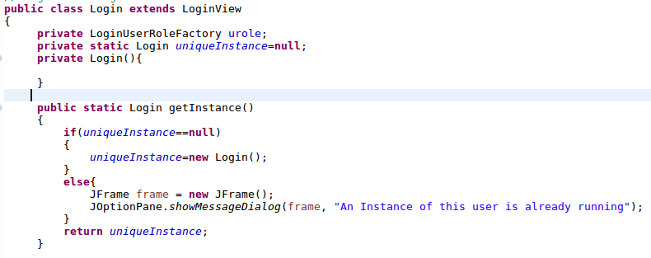
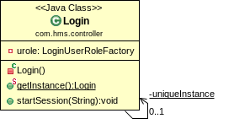
SINGLETON PATTERN

Slide 8
FUTURE DESIGN PATTERNS
Memento-To save user preferences
Flyweight -To store pictures of rooms and food items as flyweight objects
Command- To undo user selection

Slide 9
Anti Patterns
BLOB
Initially had a Single Controller in Class Diagram
Separated the controller into different controllers related to specific task

Slide 10
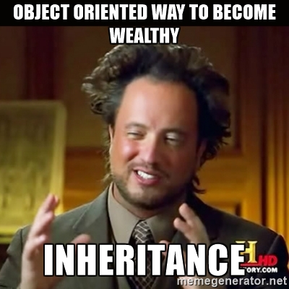
THANK YOU
ref: https://memegenerator.net/instance/64587201

